Slide 1
Circular queue using dynamic array, infix to prefix

Slide 2
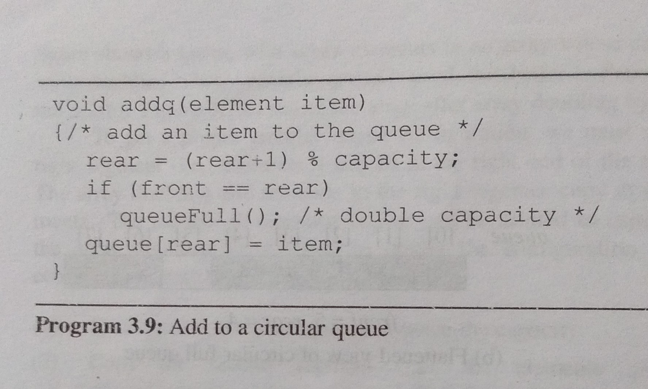

Slide 3
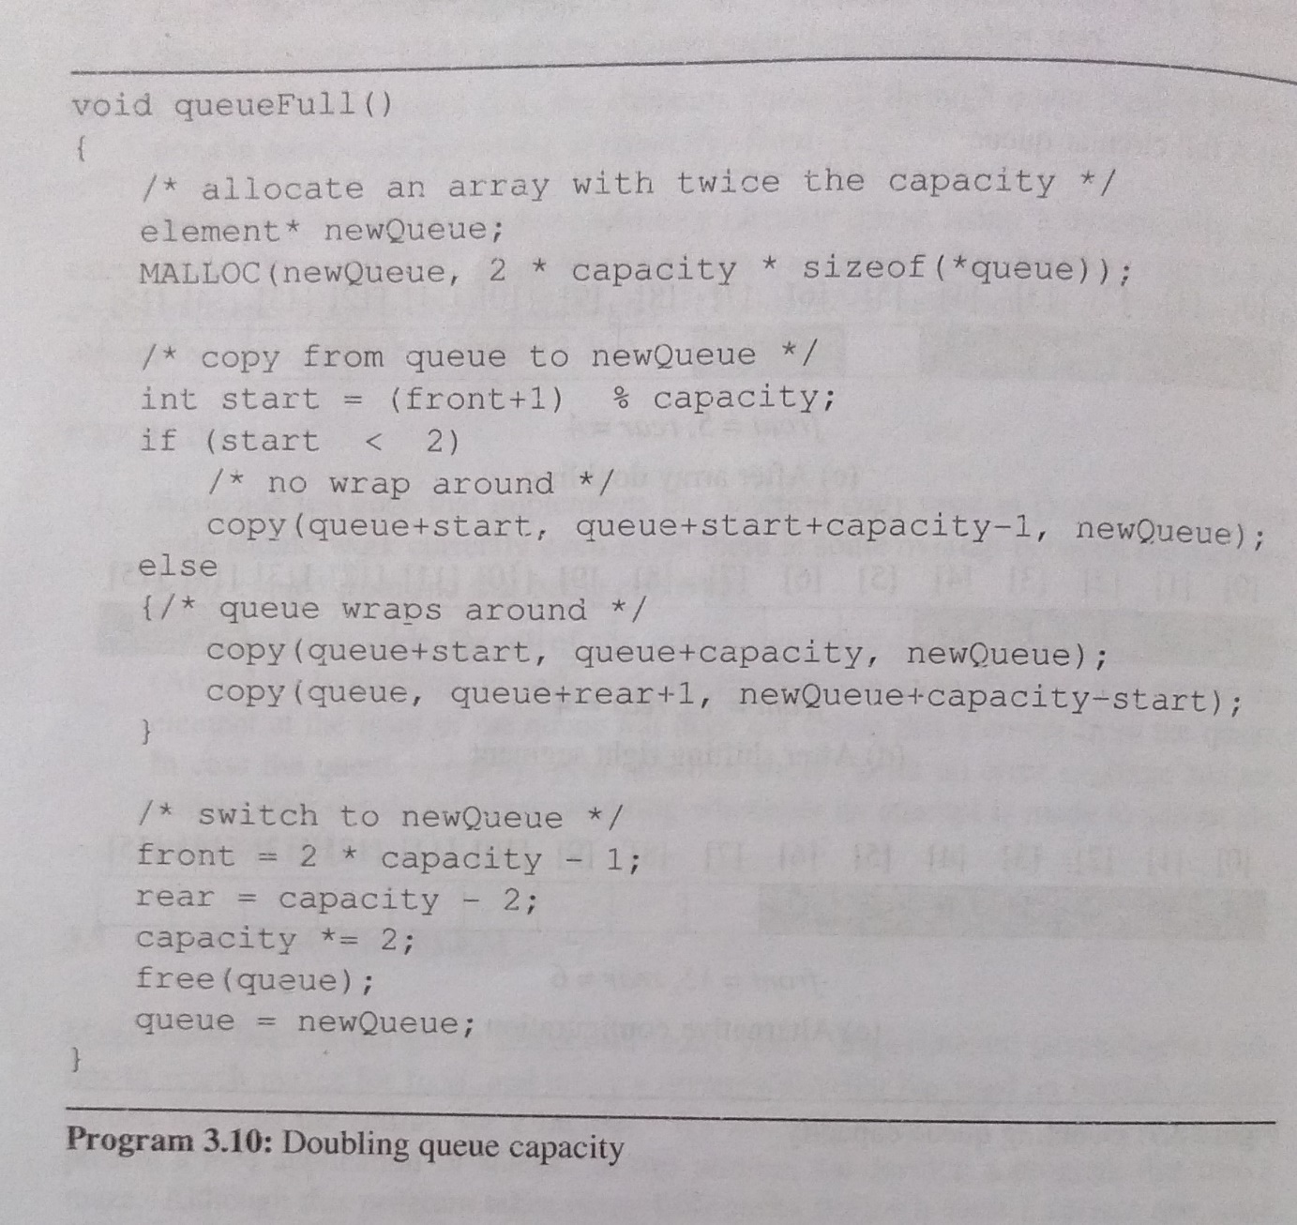

Slide 4
